Slide 1

Sentiment Classification on IMDb Reviews
Mohammed Ebrahim

Slide 2
Hyperparameter Tuning Results
Best Model Achieves 88.8% Validation Accuracy
Architecture: 16 dense units + Adam optimizer
Batch Size: 256
Training Efficiency: Plateaus at epoch 5 (no overfitting)
Grid Search Insights (Top 4 Configurations):
Adam Dominates: All top configurations used Adam (RMSprop trailed by ~7-12%).
Smaller Networks Win: 16 units outperformed 32 units in all cases.
Batch Size Impact: Smaller batches (256) slightly better than 512.
Rank
Dense Units
Optimizer
Batch Size
Val Accuracy
1
16
Adam
256
88.8%
2
32
Adam
512
88.7%
3
16
Adam
512
88.6%
4
32
Adam
256
88.4%

Slide 3
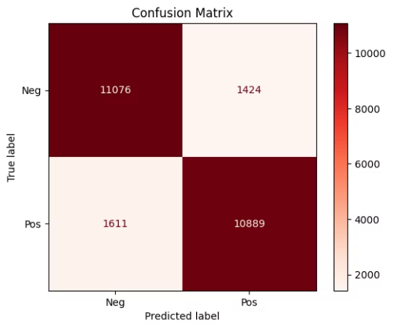
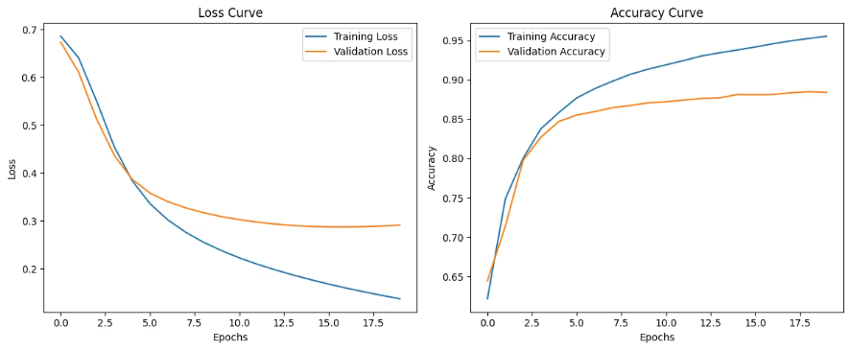
Evaluation & Insights
High true positives (10,889) but needs to reduce false negatives (1,424)
Validation loss stabilizes after 5 epochs (no overfitting detected)

Slide 4
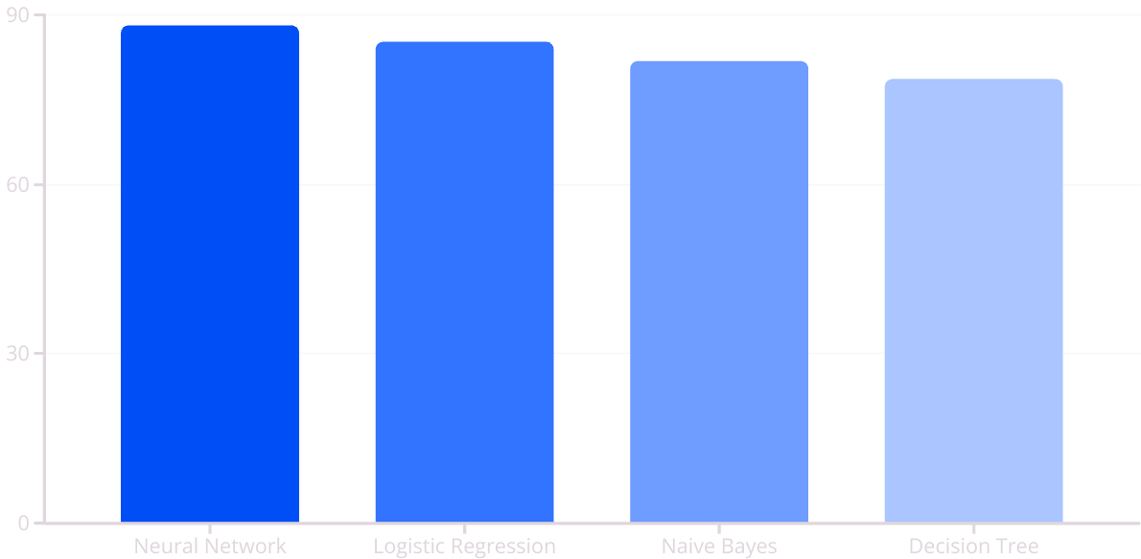
Sentiment Classification on IMDb Reviews
NN outperforms others by 2.9-9.5%
Goal: Compare deep learning (Neural Network) vs. ML baselines (Logistic Regression, Naive Bayes, Decision Tree).
Best Model: Neural Network (88.1% accuracy).
Key Tuning: Adam optimizer, 16 dense units, batch size 256.

Slide 5
Real-World Testing
Success: Correctly predicted strong sentiments (e.g., "Amazing!" → Positive).
Challenge: Struggles with nuanced reviews (e.g., "Good but disappointing" → 53% confidence)

